Slide 1

Sparse Variational Dropout and Variance Networks
Neklyudov Kirill
Notes:
Hello everyone!
Today I’ll tell you about some particular examples of Bayesian Neural Networks
Dima Molchanov has already told you about concept of Bayesian Neural Networks but now we will discuss them in details
And after this lecture there will be the seminar so you can try it by yourself

Slide 2
Agenda
Variational Dropout
Sparse Variational Dropout
Overview of other compression methods
Variance Networks
Notes:
So our agenda is following
Firstly we will discuss Variational Dropout - the ancestor of many different models
Then we discuss sparse variational dropout – improved version of variational dropout
As long as we are going to talk about sparsity I’ve decided to talk about some other sparsification methods that appeared after SVDO and VDO
And finally we will take a look at some counterintuitive results for pretty intuitive model. That is variance networks.

Slide 3
Agenda
Variational Dropout
Sparse Variational Dropout
Overview of other compression methods
Variance Networks
Notes:
And we start with Variational Dropout

Slide 4
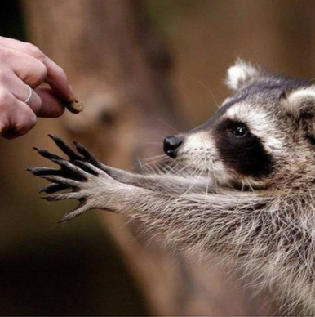
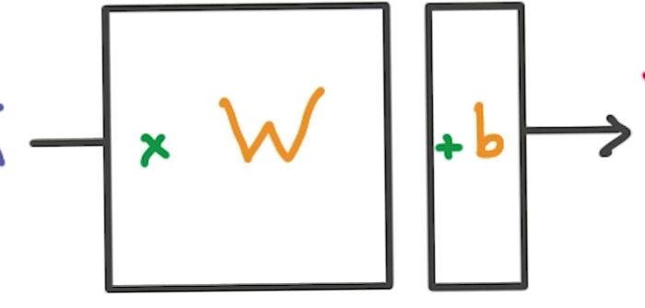

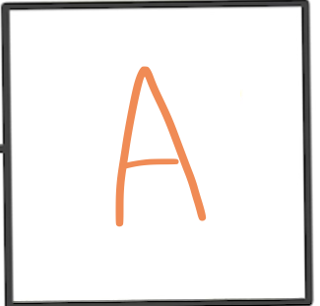
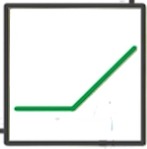
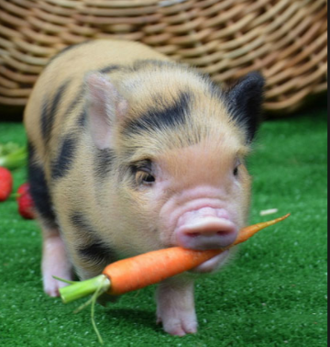

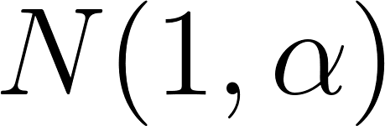
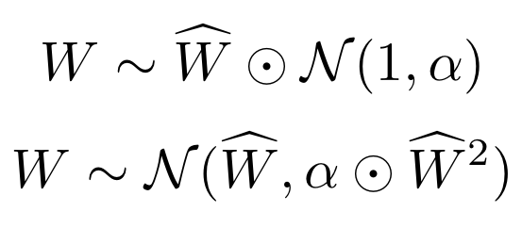
Gaussian Dropout
weights
noise
activations
nonlinearity
input
it does not change the mean value
adds multiplicative noise
Notes:
To understand the motivation of variational dropout we need to remind ourself what Gaussian Dropout is.
So let’s look at this diagram
Describe the scheme
But we can look at it at slightly different angle.
Instead of having two different layers let us have single layer with the noise inside
We can say that instead of sampling multiplicative noise we sample weights from the following distribution
where we have same mean and some variance that depends on weight matrix and some value alpha.
So we just introduced the distribution on parameters of our model
In other words we introduced variational approximation of posterior distribution
That is something Dima told you on the previous lecture.

Slide 5
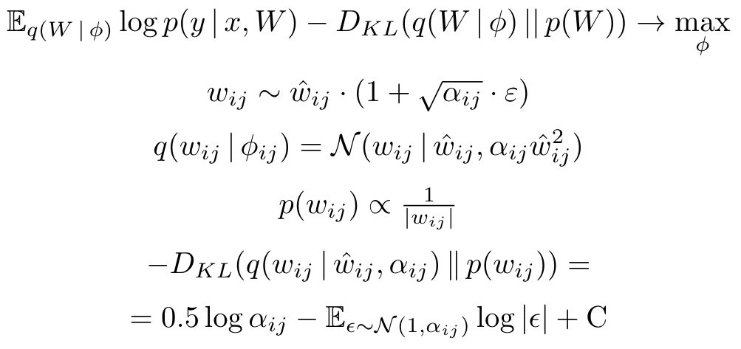
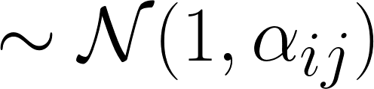
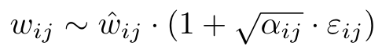
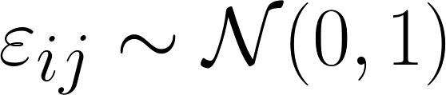
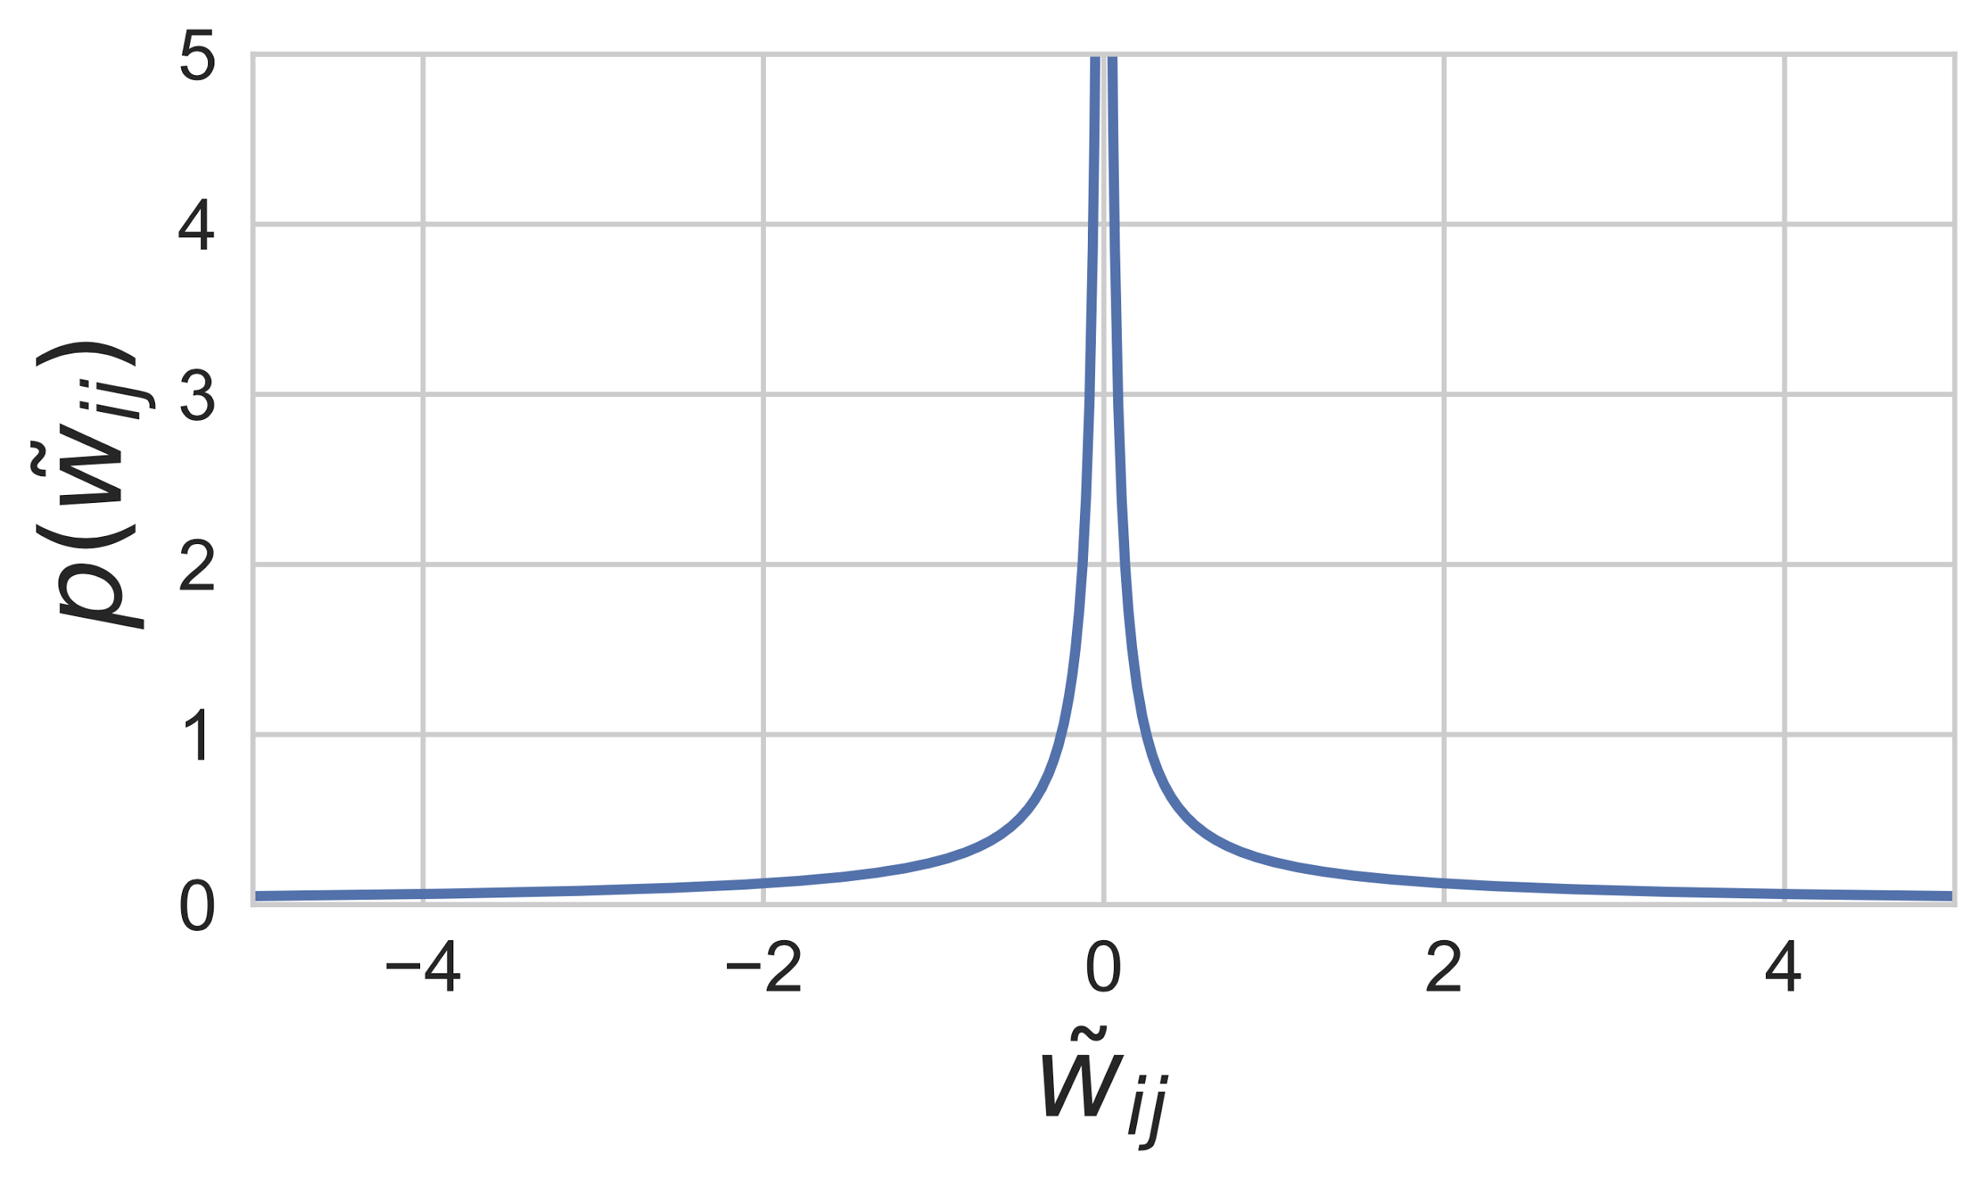
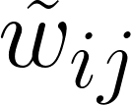
Variational Dropout
Gaussian Dropout with noise
Posterior distribution
Prior distribution and the KL divergence term
Does not depend on
Diederik Kingma, Tim Salimans, and Max Welling, Variational dropout and the local reparameterization trick
Notes:
And once we defined our approximated posterior we are in one step from formulation of our bayesian neural network
Firstly I want to remind you Variational Inference for Neural Networks
Describe formula
Then we once again introduce approximated posterior distribution but now with single alpha per weight
and as you can see we can easily sample weights using reparameterization
And here we have almost gaussian dropout noise.
So what else we need for definition of our model?
We need prior distribution of our weights
Let it be log-uniform distribution
And you can say for what reason?
And for now I can answer that we don’t want our KL divergence depend on weight parameters w_ij
What does it mean? It means that if we optimize w_ij we optimize the same network as in Gaussian Dropout
And that was initial motivation of Kingma, Salimans and Welling when they made this model
\mathbb{E}_{q(\widetilde{W}\,|\,\phi)}\log p(y\,|\,x, \widetilde{W}) - D_{KL}(q(\widetilde{W}\,|\,\phi)\,||\,p(\widetilde{W})) \to \max_\phi
\tilde{w_{ij}} \sim w_{ij} \cdot (1 + \sqrt{\alpha_{ij}} \cdot \varepsilon)
q(\tilde{w}_{ij} \,|\, \phi_{ij}) = \mathcal{N}(\tilde{w}_{ij}\,|\, w_{ij}, \alpha_{ij} w_{ij}^2)
p(\tilde{w}_{ij}) \propto \tfrac{1}{|\tilde{w}_{ij}|}
-D_{KL}(q(\tilde{w}_{ij} \,|\,\w_{ij}, \alpha_{ij})\,\|\,p(w_{ij}))=\\
0.5\log\alpha_{ij}-\mathbb{E}_{\epsilon\sim\mathcal{N}(1, \alpha_{ij})}\log|\epsilon|+\mathrm{C}

Slide 6
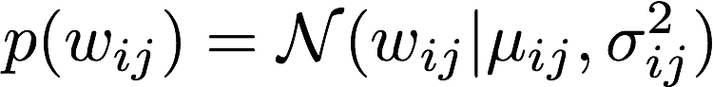
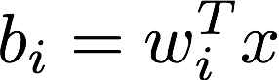
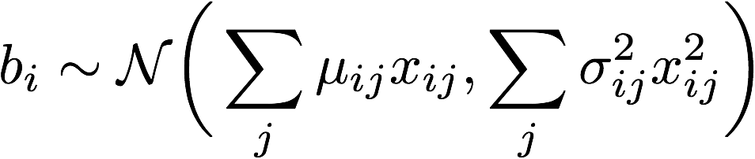
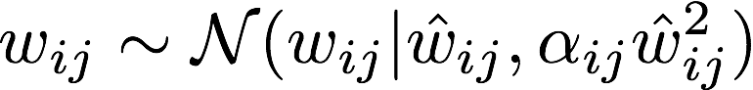
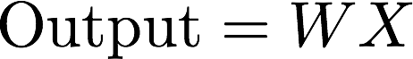
Variational Dropout with the LRT
Local Reparameterization:
Variational Dropout
+ Local Reparameterization
Notes:
Now let’s look how variational dropout will look with LRT
Assume we have some gaussian distribution for our weights and we want to sample some activation b_i that is just a scalar product of column of matrix W and input vector x
We can rewrite this activation b as two following sums
And then we can note that e_ij is a standard normal distribution and we can say that activation b_i is distributed as follows
So our model says us to sample each weight from the following distribution then multiply obtained matrix by input and then apply nonlinearity
And LRT says us that we can just calculate mean and variance of this distribution in such manner
Then sample from this distribution and then apply nonlinearity
p(w_{ij}) = \mathcal{N}(w_{ij}|\mu_{ij}, \sigma_{ij}^2)
b_i = w_i^Tx
b = \sum_{j} (\mu_{ij} + \varepsilon_{ij} \sigma_{ij}) \cdot x_{ij}
= \sum_{j} \mu_{ij} x_{ij} + \sum_{j} \varepsilon_{ij} \sigma_{ij} x_{ij}
b_i \sim \mathcal{N}\bigg(\sum_j \mu_{ij}x_{ij}, \sum_j \sigma_{ij}^2x_{ij}^2\bigg)
w_{ij} \sim \mathcal{N}(w_{ij}|\hat{w}_{ij},\alpha_{ij}\hat{w}_{ij}^2)
\text{Output} \sim \mathcal{N}(WX,(A\cdot W^2)X^2)

Slide 7
Agenda
Variational Dropout
Sparse Variational Dropout
Overview of other compression methods
Variance Networks
Notes:
So far so well
We just discussed variational dropout model and it seems pretty clear
It seems that we can easily implement it and obtain good results

Slide 8
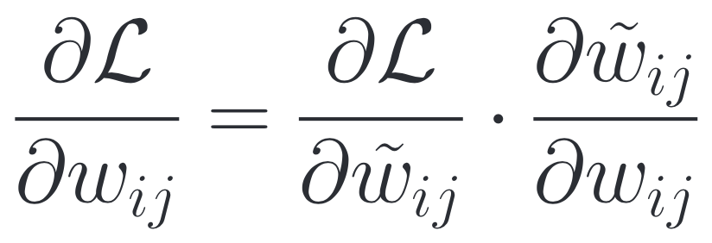
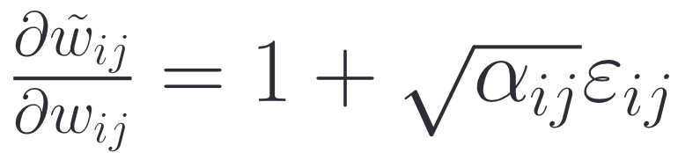
Variance Reduction
The variance of the gradients goes out of control when 𝛼 are large
Very noisy!
Solution: restrict 0 < 𝛼 < 1 (Kingma, et. al.)
It prohibits to use large alphas!
Notes:
But it turns out that there are some problems in variational dropout
For example very noisy gradients
If you take a look at the partial derivative of the ELBO by parameter w hat ij then you see that there is very noisy multiplicator
And bigger alphas we have bigger noise of the gradients we obtain
At some values of alpha we obtain just random walk in the space of parameters and that is not we are looking for
And Kingma said that we can just clip alphas to overcome this problem but now we cannot have large alphas
\frac{\partial\mathcal{L}}{\partial w_{ij}}=\frac{\partial\mathcal{L}}{\partial \tilde{w}_{ij}}\cdot\frac{\partial \tilde{w}_{ij}}{\partial w_{ij}}
\tilde{w}_{ij}=w_{ij}(1+\sqrt{\alpha_{ij}}\varepsilon_{ij})
\frac{\partial \tilde{w}_{ij}}{\partial w_{ij}}=1+\sqrt{\alpha_{ij}}\varepsilon_{ij}
\frac{\partial \tilde{w}_{ij}}{\partial w_{ij}}=1
\tilde{w}_{ij}=w_{ij}+\sqrt{\alpha_{ij}w_{ij}^2}\cdot\varepsilon_{ij}=w_{ij}+\sigma_{ij}\varepsilon_{ij}

Slide 9
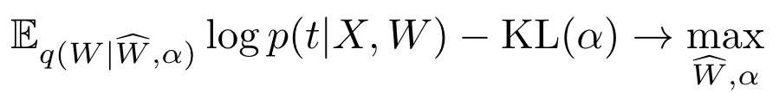
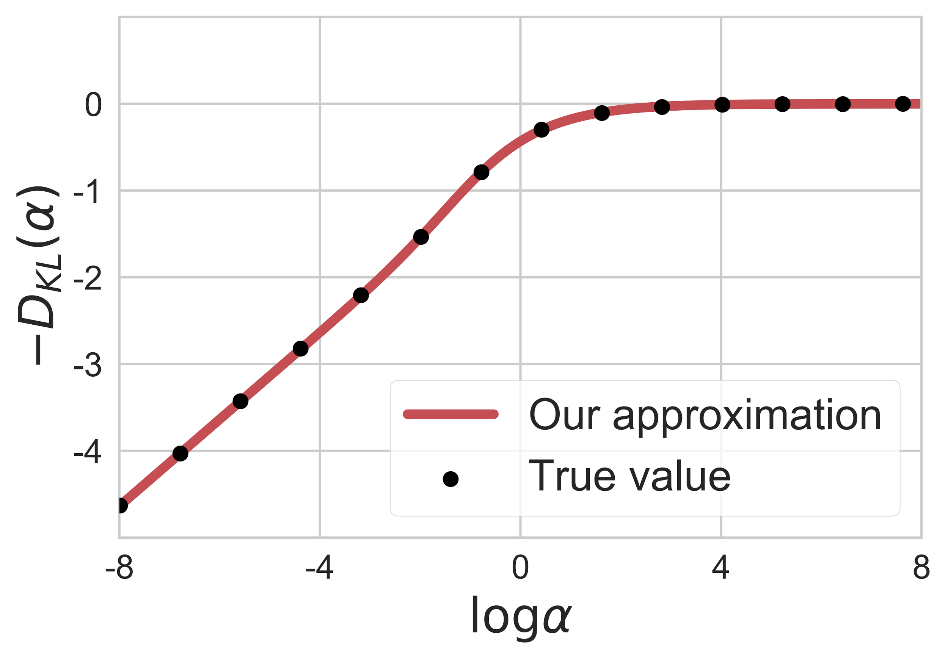
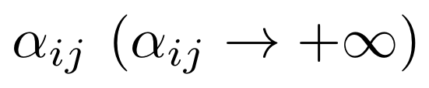
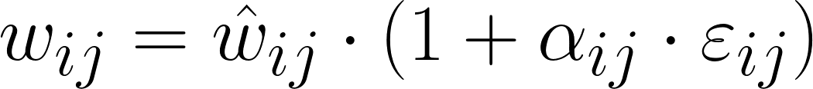
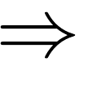
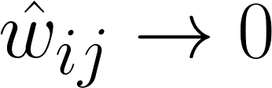
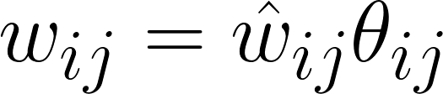
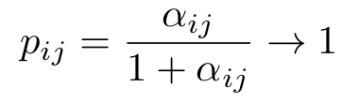
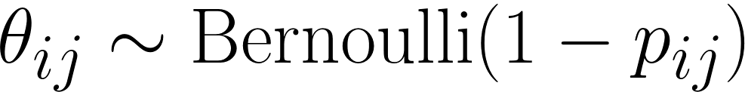
Why do we need large alphas?
The KL term favors large dropout rates α
Large means:
Infinitely large noise that corrupts the data term
Equivalent binary dropout rate goes to 1
Notes:
And one can ask why do we need large alphas? For what purpose?
Let’s think about it a little bit
We want to maximize ELBO and our negative KL divergence behaves like this
So it pushes alphas to large values
But what would happen with our means if we have very large alphas? Because on the plot we have very large alphas
It turns out that these parameters will go to zero or otherwise we will corrupt our data-term severely
Indeed we have very large noise here and totally random variables
If we have a bernoulli random variable we can also calculate alpha for it
And then we will see that probability of zero goes to one as alpha goes to infinity so that is equivalent to make the weight w_ij always equal to zero
p_{ij}=\frac{\alpha_{ij}}{1+\alpha_{ij}}\to1
\alpha_{ij}\ (\alpha_{ij}\to+\infty)
w_{ij}\to0,\ \ \ \ \ q(w_{ij})\to\mathcal{N}(\hat{w}_{ij}\,|\,0, 0)

Slide 10
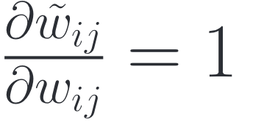
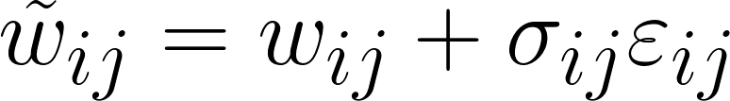
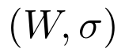
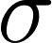
Variance Reduction
The variance of the gradients goes out of control when 𝛼 are large
Before:
Very noisy!
Solution: restrict 0 < 𝛼 < 1 (Kingma, et. al.) or …
… use Additive Noise Parameterization!
After:
No noise!
Optimize the VLB w.r.t.
is a new independent variable
Notes:
So how can we obtain large alphas if in case of large alphas we cannot learn our means?
If we will use this gradient for large alphas we just can’t set our means to zero because of totally random gradients
And the answer is to use another parameterization of our weights
Indeed in this parameterization this multiplier has no any noise and we just need to optimize wrt means and variances
\frac{\partial\mathcal{L}}{\partial w_{ij}}=\frac{\partial\mathcal{L}}{\partial \tilde{w}_{ij}}\cdot\frac{\partial \tilde{w}_{ij}}{\partial w_{ij}}
\tilde{w}_{ij}=w_{ij}(1+\sqrt{\alpha_{ij}}\varepsilon_{ij})
\frac{\partial \tilde{w}_{ij}}{\partial w_{ij}}=1+\sqrt{\alpha_{ij}}\varepsilon_{ij}
\frac{\partial \tilde{w}_{ij}}{\partial w_{ij}}=1
\tilde{w}_{ij}=w_{ij}+\sigma_{ij}\varepsilon_{ij}

Slide 11
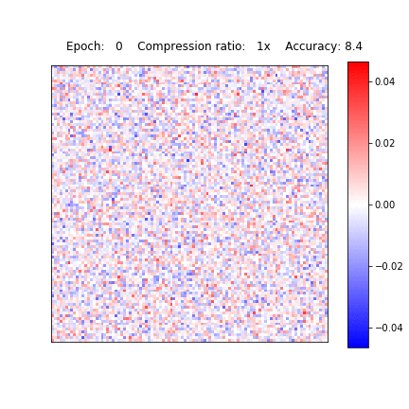
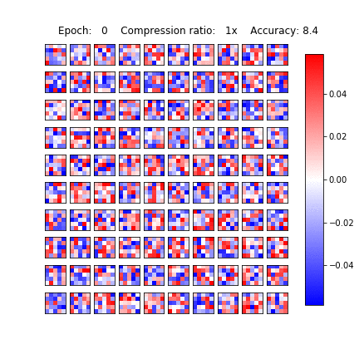
Visualization
LeNet-5: convolutional layer
LeNet-5: fully-connected layer
(100 x 100 patch)
11
Notes:
And result is on the slide
Red pixels are positive values
Blue pixels are negative values and white pixels are zero values
And here you see the process of training LeNet5 on MNIST

Slide 12
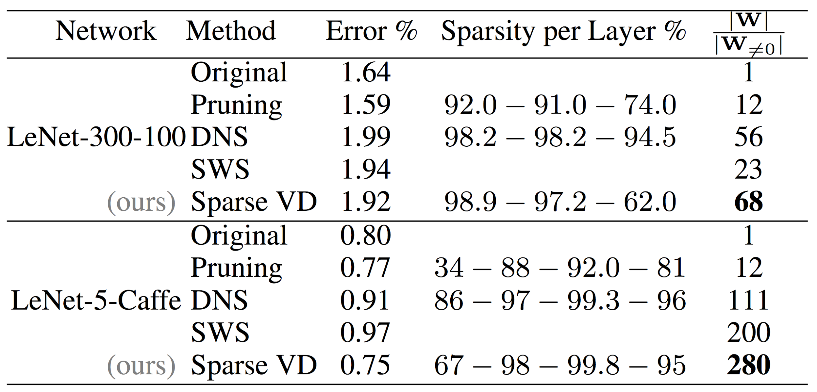
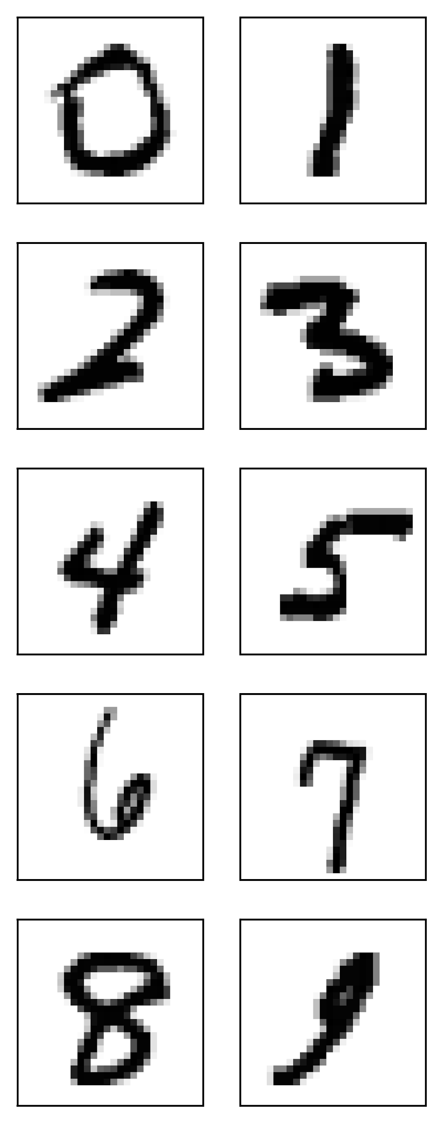
Lenet-5-Caffe and Lenet-300-100 on MNIST
Fully Connected network: LeNet-300-100 Convolutional network: Lenet-5-Caffe

Slide 13
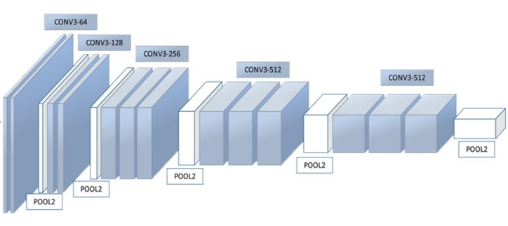
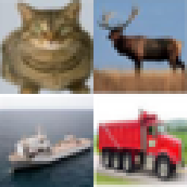
VGG-like on CIFAR-10
13 Convolutional layers and 2 Fully-Connected layers
Pre-Activation Batch Norm and Binary Dropout after each layer
Official Torch Blog: Zagoruyko, http://torch.ch/blog/2015/07/30/cifar.html

Slide 14
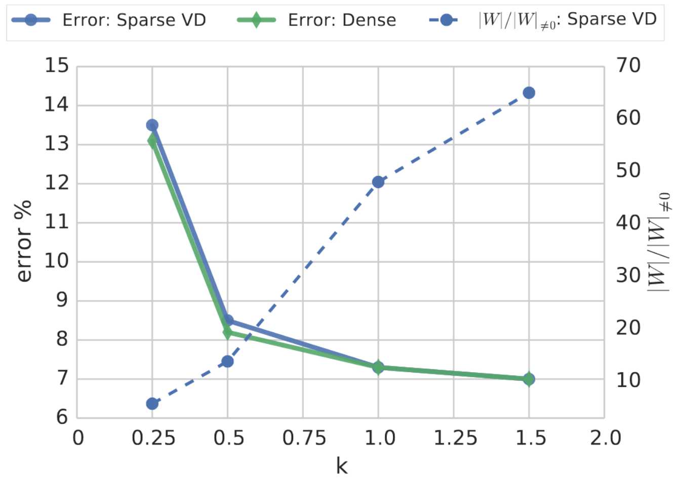
VGG-like on CIFAR-10
Number of filters / neurons is linearly scaled by k (the width of the network)
Error %
Compression rate
Model width scale factor k

Slide 15
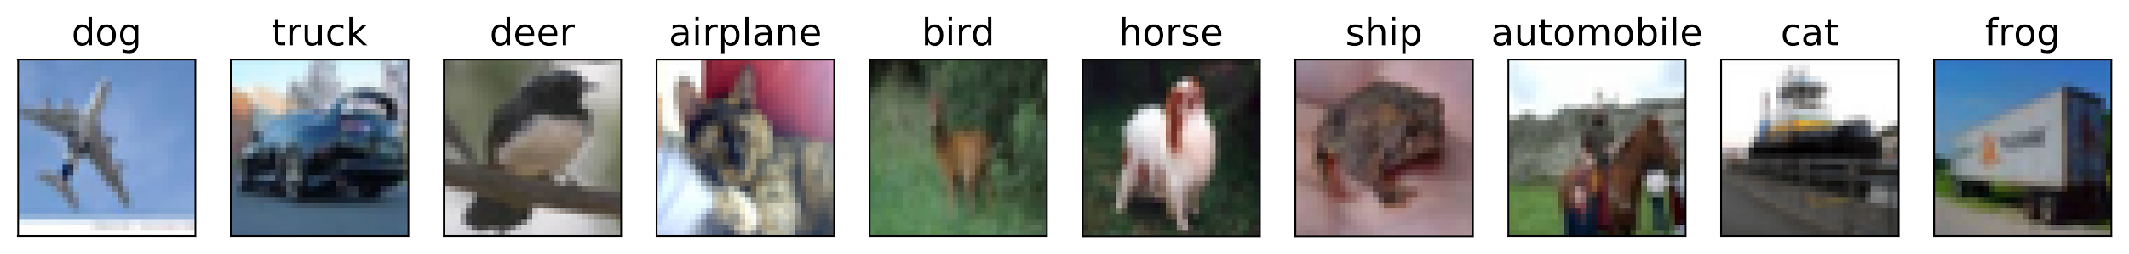
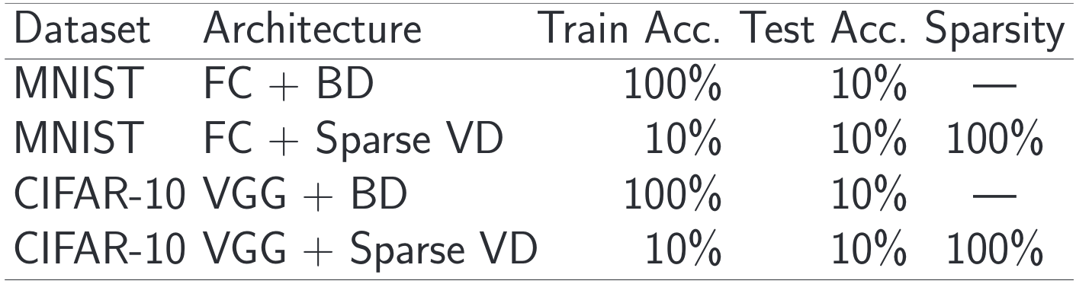
Random Labeling
No dependency between data and labels ⇒ Sparse VD yields an empty model where conventional models easily overfit.
Zhang, Chiyuan, et al. "Understanding deep learning requires rethinking generalization."

Slide 16
Agenda
Variational Dropout
Sparse Variational Dropout
Overview of other compression methods
Variance Networks
Notes:
So as we start discus sparsity let’s take a brief look at other methods that appears after Sparse variational dropout

Slide 17
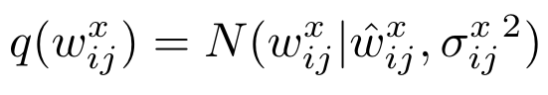
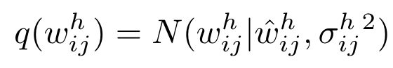
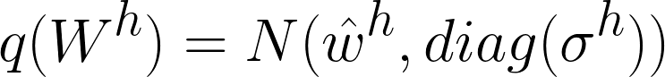
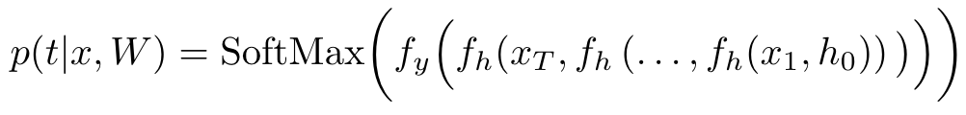
Bayesian Sparsification of Recurrent Neural Networks
Log-uniform prior
The same sample W for all timestamps
We cannot perform LRT
Notes:
But here we cannot apply LRT for matrices Wx and Wh because we need to use the same matrices Wx and Wh for all elements of sequence
You can think of it as we want to sample one RNN and use it for one sequence and as long every step of RNN use the same matrices we should fix them for one sequence

Slide 18
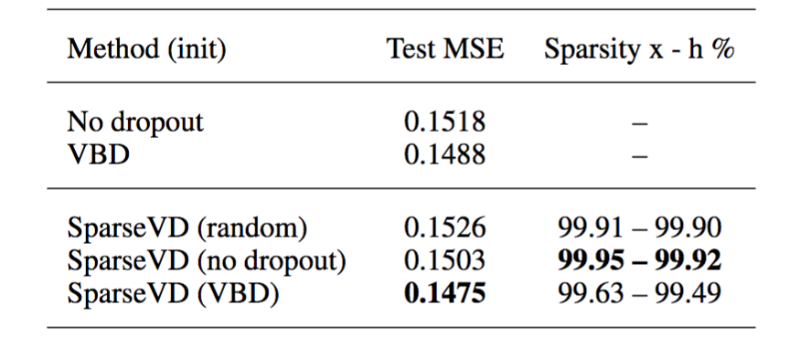
Bayesian Sparsification of RNNs: Sentiment Analysis

Slide 19
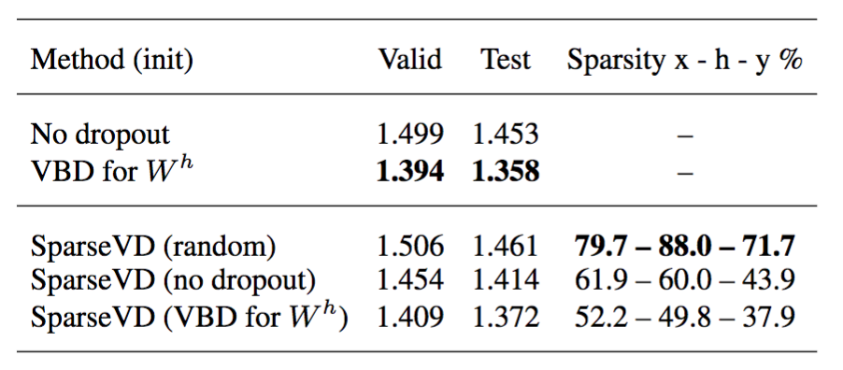
Bayesian Sparsification of RNNs: Language Modeling

Slide 20
Group sparsity
Sparse VD provides general sparsity with no structure
Sparse VD can’t be efficiently generalized for group sparsity
Structured sparsity is the key to DNN acceleration
Structured sparsity allows more efficient compression

Slide 21
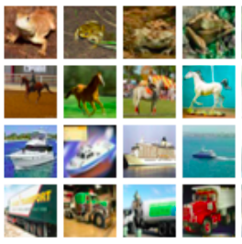
Activations sparsity
input
weights
noise
activations
nonlinearity
input
weights
activations
nonlinearity
noise

Slide 22
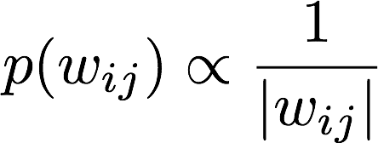

Distributions
Variational Dropout:
Log-Normal Dropout:

Slide 23

Results on MNIST

Slide 24
Agenda
Variational Dropout
Sparse Variational Dropout
Overview of other compression methods
Variance Networks

Slide 25
Gaussian Dropout
weights
noise
activations
nonlinearity
input
it does not change the mean value
adds multiplicative noise
Notes:
Let’s look at gaussian dropout one more time
Here we have single alpha per layer, but we just discussed model with individual alphas per weights
Let’s look what will happen if we make single alpha per layer

Slide 26


Variational Dropout
Posterior distribution
Prior distribution and the KL divergence term
Diederik Kingma, Tim Salimans, and Max Welling, Variational dropout and the local reparameterization trick
Notes:
Variational dropout doesn’t change so much
We just need to sample our weights using single value alpha
And calculate KL divergence using this single value
So nothing outstanding in theory
\mathbb{E}_{q(\widetilde{W}\,|\,\phi)}\log p(y\,|\,x, \widetilde{W}) - D_{KL}(q(\widetilde{W}\,|\,\phi)\,||\,p(\widetilde{W})) \to \max_\phi
\tilde{w_{ij}} \sim w_{ij} \cdot (1 + \sqrt{\alpha_{ij}} \cdot \varepsilon)
q(\tilde{w}_{ij} \,|\, \phi_{ij}) = \mathcal{N}(\tilde{w}_{ij}\,|\, w_{ij}, \alpha_{ij} w_{ij}^2)
p(\tilde{w}_{ij}) \propto \tfrac{1}{|\tilde{w}_{ij}|}
-D_{KL}(q(w_{ij} \,|\,\hat{w}_{ij}, \alpha)\,|\,p(w_{ij}))=\\
0.5\log\alpha-\mathbb{E}_{\varepsilon\sim\mathcal{N}(1, \alpha)}\log|\epsilon|+\text{C}

Slide 27

What will happen?
CIFAR-10
?
Notes:
But on practice something strange starts to happen

Slide 28

Something weird is happening
CIFAR-10
$$α>{10}^{5}$$
Notes:
But on practice something strange starts to happen

Slide 29




Variational dropout converges to a variance network
Let’s take a look at alpha
We have almost zero Signal-to-Noise Ratio (SNR)
Means are negligible compared to variances
Theorem
Notes:
\text{MMD}\bigg(\mathcal{N}(\hat{w}_{ij},\alpha\hat{w}_{ij}^2)\bigg|\bigg|\mathcal{N}(0,\alpha\hat{w}_{ij}^2)\bigg) \to 0 \;\;\;\;\; \text{as}\;\;\;\;\; \alpha \to \infty

Slide 30


Variance Netrworks
Posterior distribution
Prior distribution and the KL divergence term
Notes:
\mathbb{E}_{q(\widetilde{W}\,|\,\phi)}\log p(y\,|\,x, \widetilde{W}) - D_{KL}(q(\widetilde{W}\,|\,\phi)\,||\,p(\widetilde{W})) \to \max_\phi
\tilde{w_{ij}} \sim w_{ij} \cdot (1 + \sqrt{\alpha_{ij}} \cdot \varepsilon)
q(\tilde{w}_{ij} \,|\, \phi_{ij}) = \mathcal{N}(\tilde{w}_{ij}\,|\, w_{ij}, \alpha_{ij} w_{ij}^2)
p(\tilde{w}_{ij}) \propto \tfrac{1}{|\tilde{w}_{ij}|}
-D_{KL}(q(w_{ij} \,|\,\hat{w}_{ij}, \alpha)\,|\,p(w_{ij}))=\\
0.5\log\alpha-\mathbb{E}_{\varepsilon\sim\mathcal{N}(1, \alpha)}\log|\epsilon|+\text{C}

Slide 31


Different parameterizations
Variance network is actually the best possible variational dropout network!
Sparse Variational Dropout is just a poor local optimum 😔

Slide 32

Experiments: classification

Slide 33








Intuition of Variance networks on toy problem
Dataset:
Model:
Variance layer with output

Slide 34



Intuition of Variance networks on toy problem

Slide 35

Information flow from means to variances
MNIST

Slide 36

Information flow from means to variances
MNIST
MNIST

Slide 37
Conclusions
Variational Dropout is one of the first examples of Bayesian Neural Networks
A lot of different models with totally different properties appeared from Variational Dropout
Variational Inference is a powerful framework for building Bayesian Neural Networks
We can efficiently store information in the variances (if we remove means 🙃)
Don’t forget about pitfalls of Weight Scaling Rule

